Slide 1
LENDING CLUB CASE STUDY
Indraja Punna

Slide 2
Problem statement
The consumer finance company faces a critical decision-making challenge in approving loans, balancing the risk of business loss if a creditworthy applicant is denied and the financial loss if a likely defaulter is approved.
The objective is to analyze past loan applicant data to identify patterns that signal potential defaults, enabling the company to make informed decisions such as denying loans, reducing loan amounts, or adjusting interest rates for risky applicants.
The company aims to optimize its loan approval process by leveraging historical data to minimize both business loss and financial risk associated with loan approvals.

Slide 3
APPROACH
Data Cleaning
Data Analysis
a. Univariate Analysis
b. Bi-variate Analysis
c. Multi-variate Analysis
3. Data Insights

Slide 4


DATA CLEANING
CLEAN COLUMNS
CLEAN ROWS
Create a list of unneeded columns and drop them
Drop all the columns where mean percentage of null values is greater than 30.
Drop all the columns where there is only a single unique value
Convert date fields and numeric fields into correct formats
Impute rows for numerical and categorical columns.
For numerical columns rows are imputed with median
For categorical columns rows are imputed with mode.
Removed rows with categories like Other which do not make much sense

Slide 5
UNIVARIATE ANALYSIS - APPROACH
We will be analyzing only the data with the status of loan as fully paid and charged off to find the insights.
Categorized each column into either numerical or categorical.
Created a histogram for each column in numerical columns list to derive business insights from it.
Created a count plot for each column in categorical columns list to derive business insights from it.

Slide 6
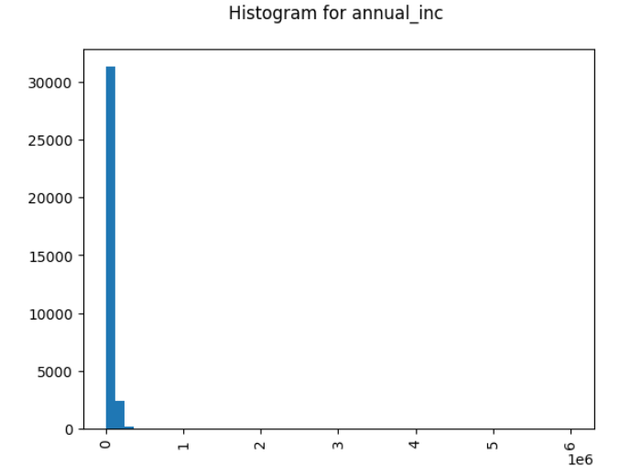
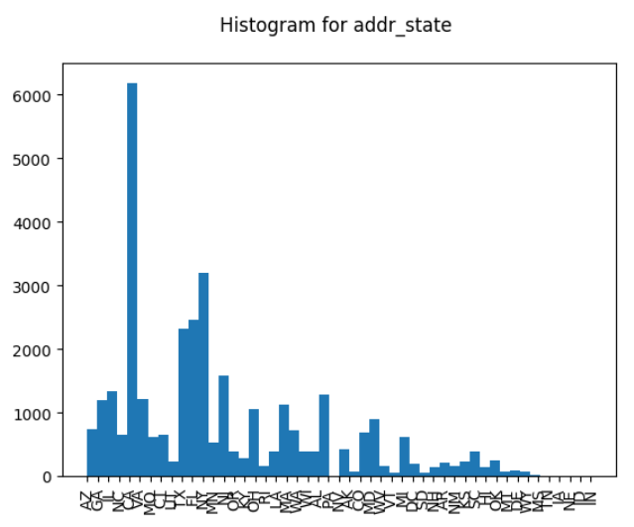
UNIVARIATE ANALYSIS - INSIGHTS
NUMERICAL COLUMNS
Majority of people who have taken loan had an annual increment between 0 to 1 lakh
HIGHEST NUMBER of people who TOOK THE loan ARE FROM THE state of CA

Slide 7
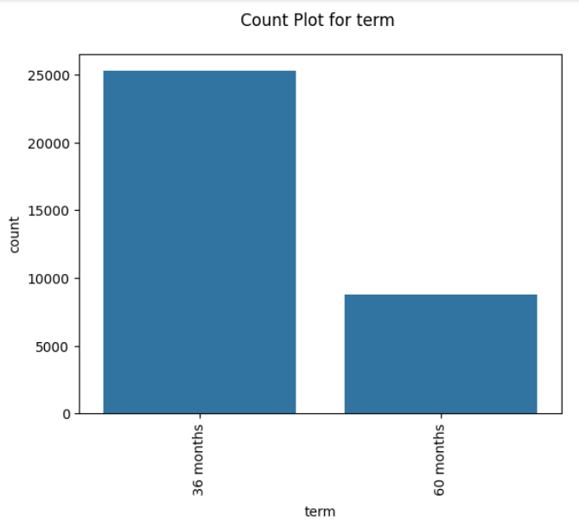
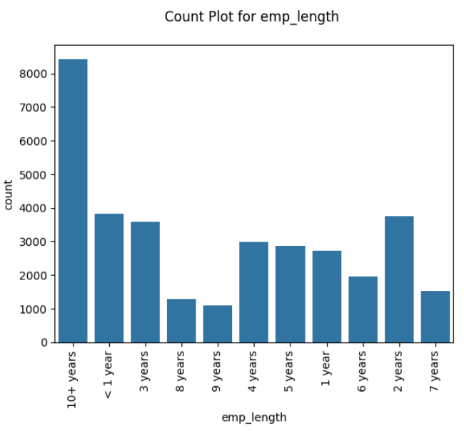
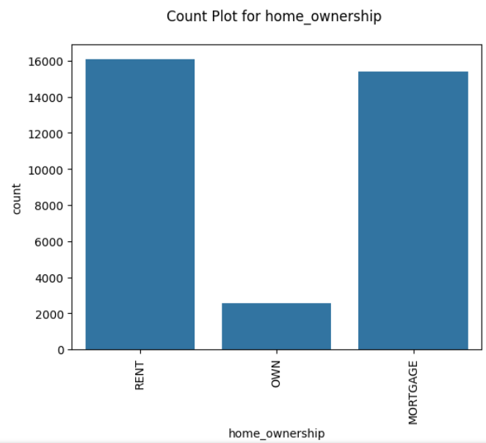
UNIVARIATE ANALYSIS - INSIGHTS
CATEGORICAL COLUMNS
NUMBER OF PEOPLE WHO TOOK LOAN FOR 36 MONTHS TERM ARE MORE THAN DOUBLE THAT OF THOSE WHO TOOK FOR 60 MONTHS TERM
Majority of people who TOOK loan HAVE employment DURATION OF MORE THAN 10 YEARS.
People who already own a home took the least number of loans

Slide 8
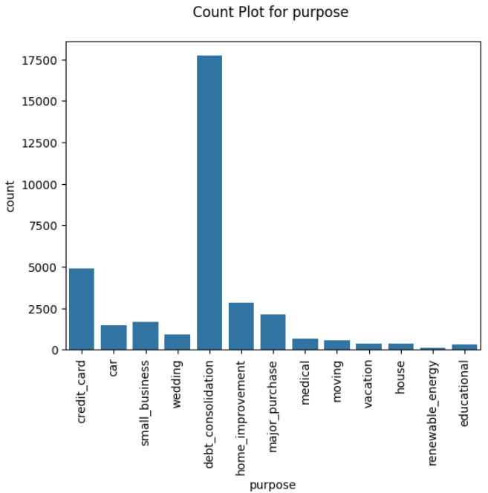
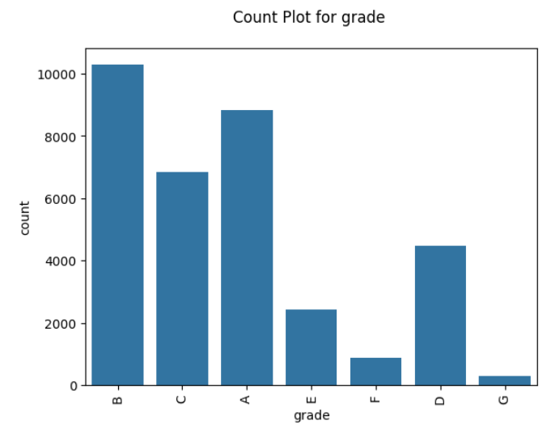
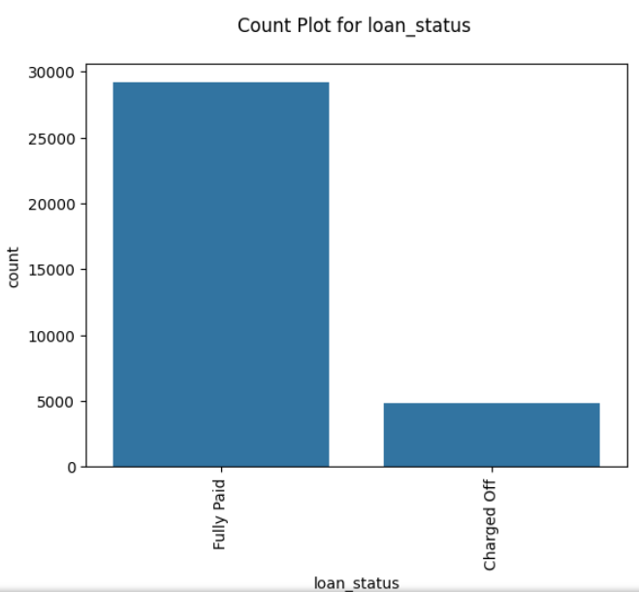
UNIVARIATE ANALYSIS - INSIGHTS
CATEGORICAL COLUMNS
Majority of people took loan for the purpose of debt consolidation
Majority of people who have taken loan fall in grades B and A. Least NUMBER OF THEM fall in grade G
NUMBER OF PEOPLE WHO DEFAULTED ARE 18% OF NUMBER OF PEOPLE WHO FULLY PAID

Slide 9
bivariate ANALYSIS - APPROACH
Created a scatter plot for each column in numerical columns vs numerical to derive business insights from it.
Created a box plot for each column in categorical columns vs numerical columns to derive business insights from it.
Created a bar plot for each column in categorical columns vs categorical columns to derive business insights from it.

Slide 10
BIVARIATE ANALYSIS - INSIGHTS
NUMERICAL VS NUMERICAL
“installment vs loan_amnt”
in most of the cases the higher the loan amount installments also increase

Slide 11
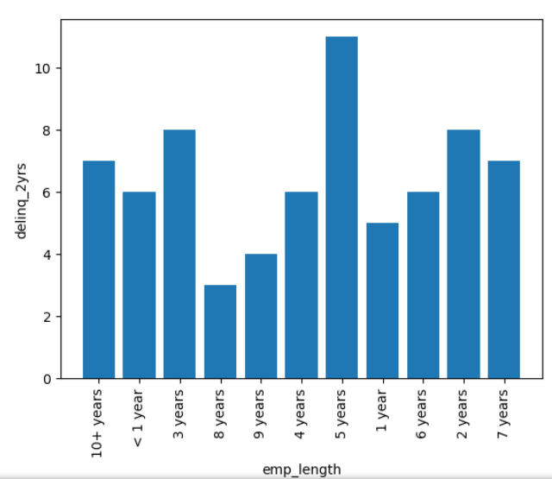
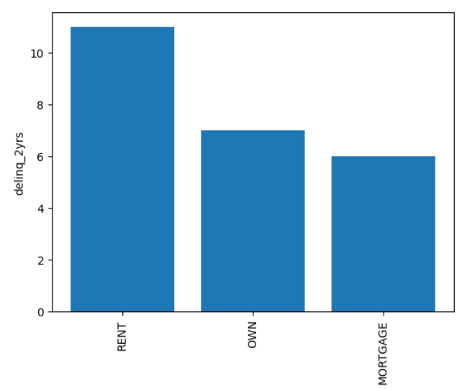
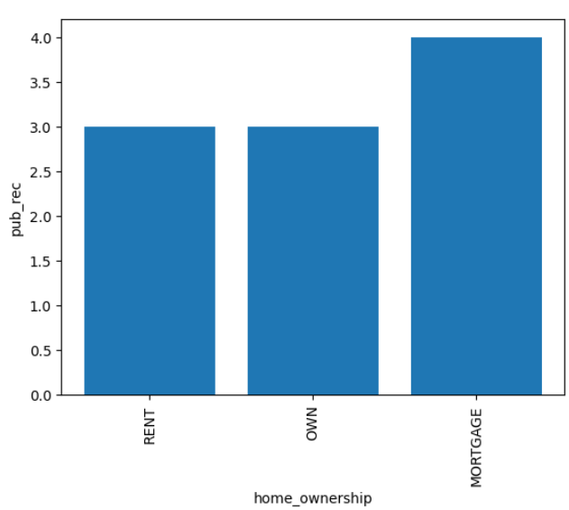
BIVARIATE ANALYSIS - INSIGHTS
CATEGORICAL VS CATEGORICAL
people Whose employment duration is 5 years have highest showed highest delinquency in past 2 years
Renters have shown highest delinquency in the past 2 years than others
Mortgage people have highest number of derogatory public records

Slide 12
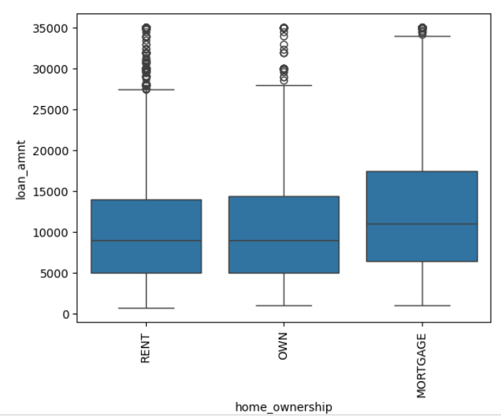
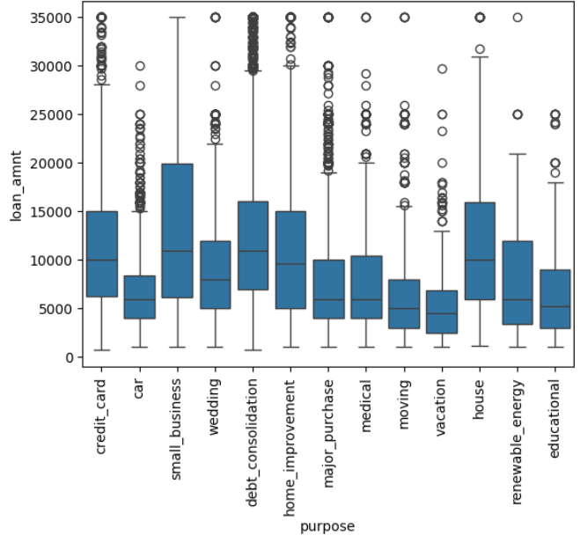
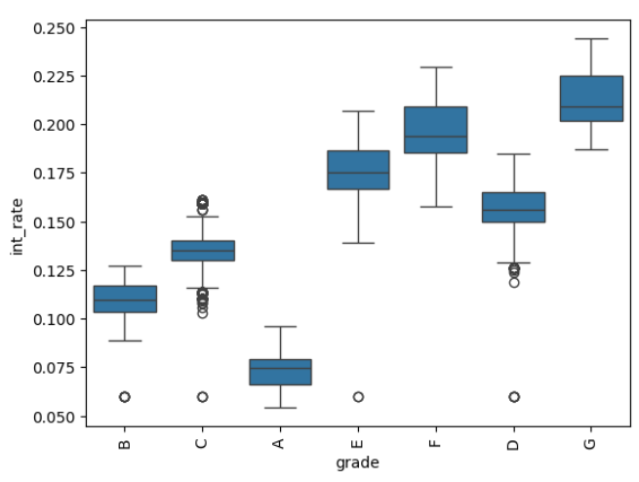
BIVARIATE ANALYSIS - INSIGHTS
NUMERICAL VS CATEGORICAL
people in mortgage have taken higher loan amount
people who wanted to do small business have taken higher loan amount next comes house purchase
people in grade A have taken least interest rate. people in grade G are paying highest interest rate

Slide 13
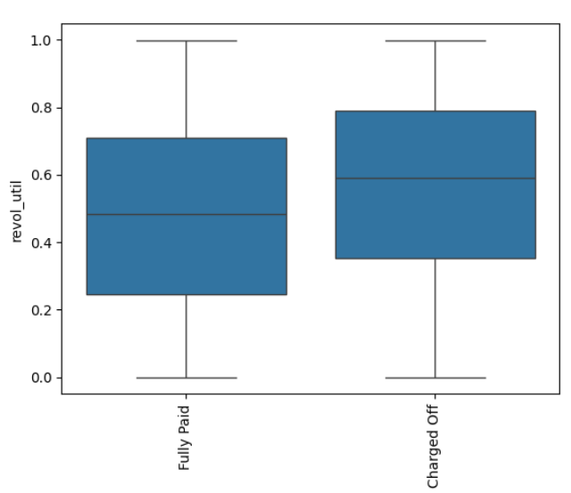
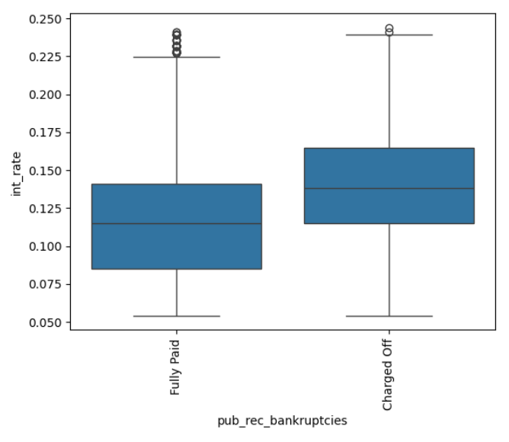
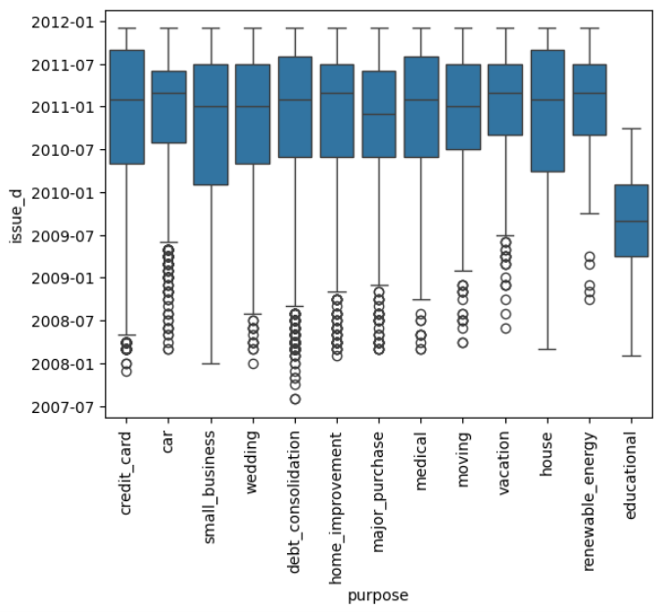
BIVARIATE ANALYSIS - INSIGHTS
NUMERICAL VS CATEGORICAL
people with status as charged off have slightly higher revolving utilization rate
DEFAULTERS HAVE TAKEN LOANS WITH HIGHER INTEREST RATES. Higher than 50 percentile of fully paid people
educational loan is issued only between 2009 and 2010

Slide 14
MULTI-VARIate ANALYSIS - APPROACH
Created a heatmap with correlation
Created a new derived field defaulter with values 0 or 1 to include in the heat map.

Slide 15
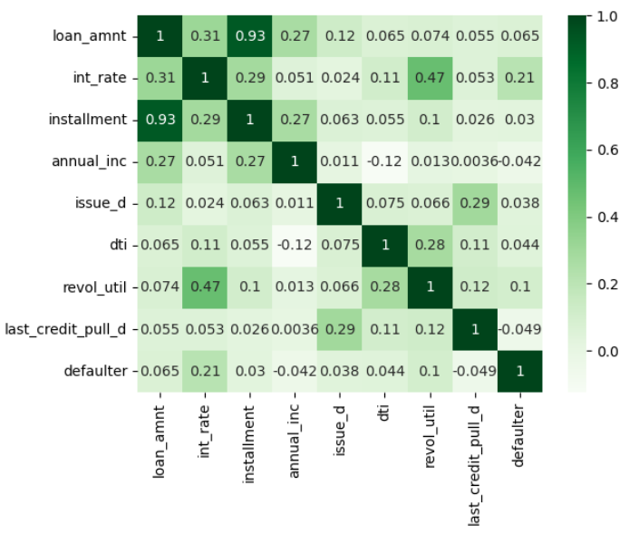
MULTIVARIATE ANALYSIS - INSIGHTS
Annual increment and Defaulter are negatively correlated. This means if a person gets less annual increment he has a higher chance to default
Last_credit_pull and defaulter are negatively correlated. This means there is a high chance of a person being a defaulter if you haven’t pulled his latest credit details.

Slide 16
FINAL INSIGHTS
Defaulters have taken loans with higher interest rates. Higher than 50 percentile of fully paid people. People who are willing to take loan even with higher interest rate might become a defaulter.
Number of people who defaulted are 18% of number of people who fully paid.
Annual increment and Defaulter are negatively correlated. This means if a person gets less annual increment he has a higher chance to default
Last_credit_pull and defaulter are negatively correlated. This means there is a high chance of a person being a defaulter if you haven’t pulled his latest credit details.

Slide 17
THANK YOU
Indraja Punna
Indraja.punna@gmail.com

